Slide 1






VIKAS: Virtually Intelligent Knowledge Assisted Shopping.
Connecting online shopping to offline store fulfillment.

Slide 2

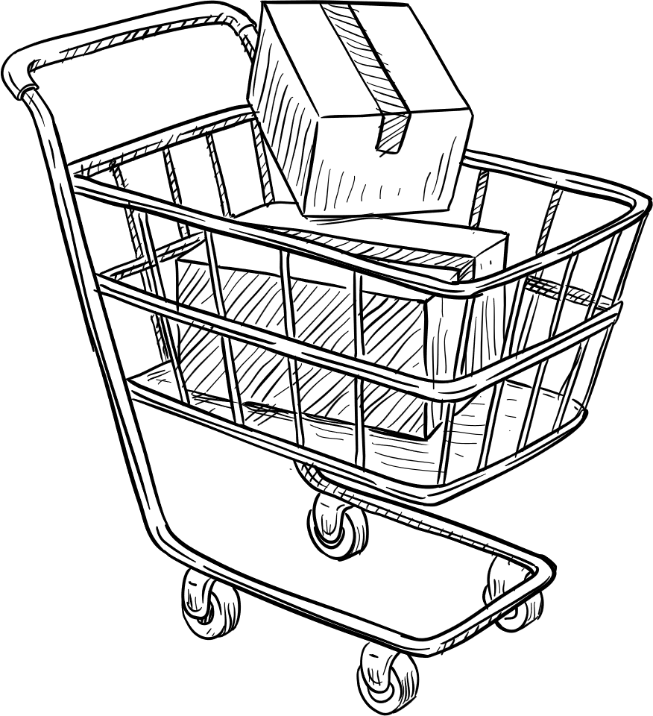
The Consumer Reality vs. The Retail Gap
Demand Surge: Stores face 3–5x traffic spikes during festivals, leading to dangerous overcrowding.
Inventory Gap: Disconnect between "online in-stock" status and actual shelf availability.
Impact: 65% of customers abandon brands after one poor fragmented experience.

Slide 3


The Solution: Online Search, Offline Pickup
Seamless O2O: Users find products online and reserve them at a local physical store.
Queue Reduction: Decreases in-store billing congestion by an estimated 50%.
Reliability: Guarantees the product is waiting for the customer upon arrival.

Slide 4

Core Flow: QR-Based 48H Reservations
Instant Booking: Users reserve products online for a specific local store location.
Reservation Fee: A flat convenience fee of ₹30 is charged at the time of booking to secure the inventory.
48-Hour Guarantee: Once booked, the item is locked in the system and guaranteed for a two-day pickup window.
QR Pickup: Users receive a unique secure code for instant, "no-wait" verification at the store.

Slide 5
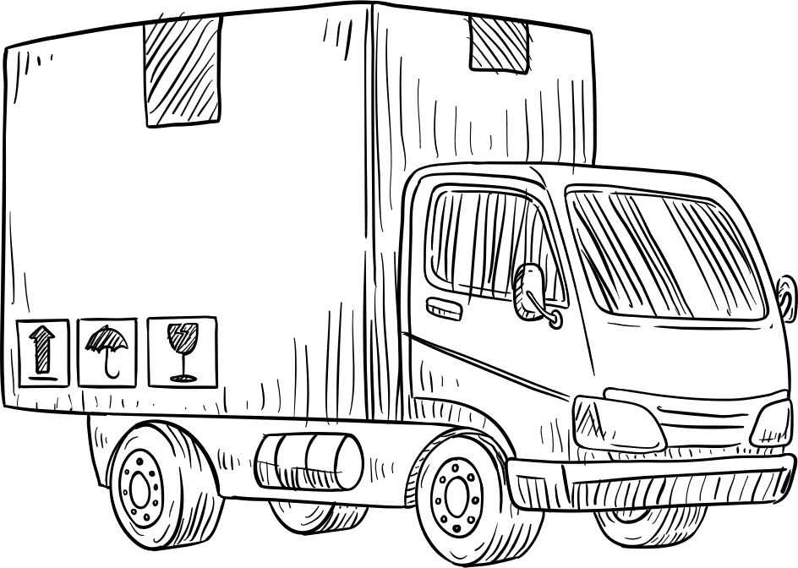
Architecture: Multi-Agent AI Core
Orchestrator Agent: The cognitive "brain" that interprets intent and delegates tasks to specialists.
Personalization Agent: Maps style affinity and browsing behavior for hyper-relevant recommendations.
Product & Inventory Agent: Real-time stock sync with ERP systems to prevent overbooking.
Immersive Experience Agent: A modular unit ready to power 3D visualizations and AR try-ons.

Slide 6
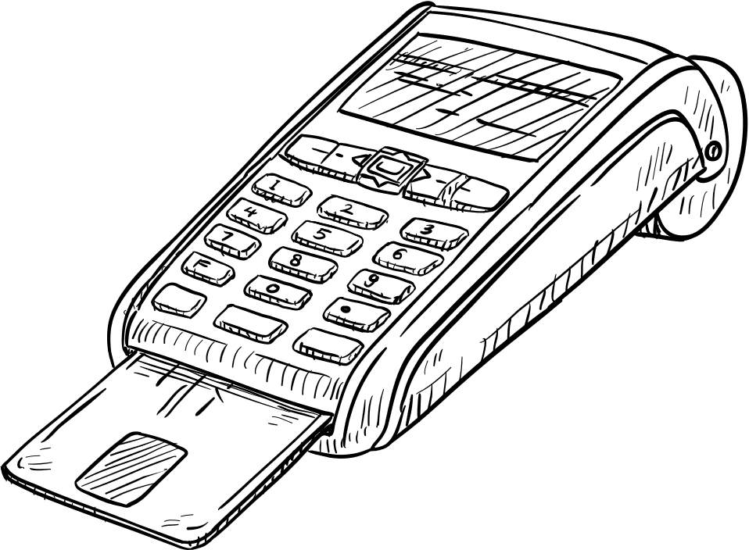
Core Pillars of Seamless Retail
01 Hyper-Personalization: Predictive analytics anticipate needs before customers ask.
02 Proactive Clienteling: Autonomous outreach for out-of-stock items or new collections.
03 Seamless Handoff: Start on web, finish in-store with zero information loss.
04 Immersive AR: Virtual try-ons to reduce purchase uncertainty and lower return rates.
05 24/7 Support: Instant, multi-language automated support across every channel.

Slide 7

Future Perspective: Immersive & Express
Immersive AR Shopping: Virtual "view in room" and face-tracking try-ons via Mediapipe to reduce returns.
O2O Same-Day Delivery: Optional hyper-local delivery from the reserved store to the user’s doorstep.
Express Pricing: Dedicated fee structure for delivery (₹40 for standard / ₹80–100 for large items).

Slide 8

Future Perspective: Flexibility & Scale
Extended Pickup Windows: Option to extend the 48-hour reservation by an extra 24 hours for a ₹20 convenience fee.
AI Demand Forecasting: Predictive analytics for store managers to prevent stock-outs during massive festive spikes.
Live CCTV Integration: Potential for real-time crowd detection to manage store safety.

Slide 9
Impact: Scaling Festive Commerce
The future of VIKAS lies in transforming fragmented retail into intelligent event infrastructure. By merging real-time inventory orchestration with predictive AI, we don't just solve shopping—we solve the omnichannel crisis. With evolving technology, VIKAS will continue to bridge the gap between digital intent and physical fulfillment.

Slide 10
conclusion
VIKAS is event-driven retail intelligence infrastructure designed to manage festive surges through intelligent orchestration and queue reduction.

